Slide 1

Software Testing & Quality (06)
Configuration Testing

Slide 2
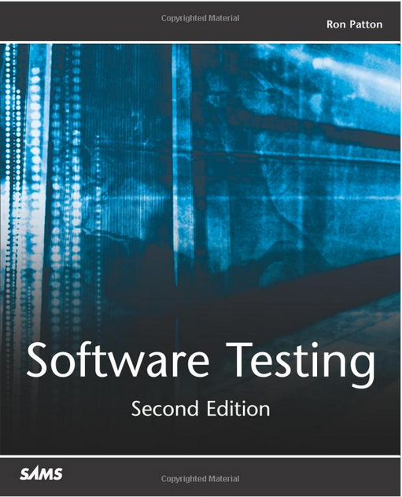
Book
2nd Edition, Ron Patton, Sams Publishing, 2005

Slide 3
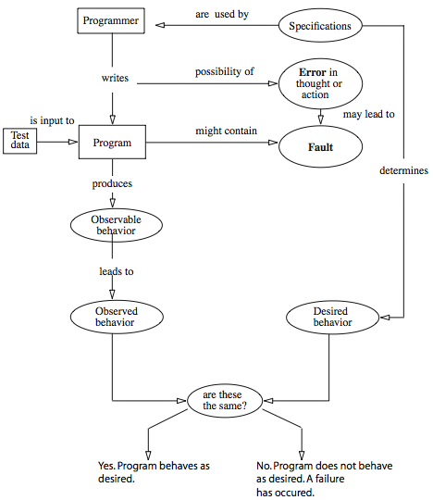
Error, faults, failures
from Foundations of Software Testing, A. P. Mathur, Purdue University

Slide 4
Software Performance Testing
In software engineering, performance testing is in general testing performed to determine how a system performs in terms of responsiveness and stability under a particular workload.
It can also serve to investigate, measure, validate or verify other quality attributes of the system, such as scalability, reliability and resource usage.
Notes:
Performance testing is a subset of performance engineering, an emerging computer science practice which strives to build performance into the design and architecture of a system, prior to the onset of actual coding effort.

Slide 5
Performance Testing Type
Load testing
Stress testing
Endurance testing (soak testing)
Spike testing
Configuration testing
Isolation testing

Slide 6
Load Testing
Load testing is the simplest form of performance testing
  A load test is usually conducted to understand the behavior of the system under a specific expected load.
  This load can be the expected concurrent number of users on the application performing a specific number of transactions within the set duration.

Slide 7
Stress Testing
Stress testing is normally used to understand the upper limits of capacity within the system
  This kind of test is done to determine the system's robustness in terms of extreme load and helps application administrators to determine if the system will perform sufficiently if the current load goes well above the expected maximum.

Slide 8
Endurance Testing (Soak Testing)
Endurance testing is usually done to determine if the system can sustain the continuous expected load
  During endurance tests, memory utilization is monitored to detect potential leaks. Also important, but often overlooked is performance degradation.
  It essentially involves applying a significant load to a system for an extended, significant period of time.
  The goal is to discover how the system behaves under sustained use.

Slide 9
Spike Testing
Spike testing is done by suddenly increasing the number of, or load generated by, users by a very large amount and observing the behavior of the system
  The goal is to determine whether performance will suffer, the system will fail, or it will be able to handle dramatic changes in load.

Slide 10

Disney’s “Lion King Animated Storybook” 1994
Disney released its first multimedia CD-ROM for children
A major ad campaign touting it as “the game to buy”
After Christmas Day, many angry parents were on the phone to Disney with crying children in the background
The problem was the game worked on only a few platforms and nothing was said about this on the wrapper as Disney hadn’t realized the problem

Slide 11
Configuration Testing
Rather than testing for performance from the perspective of load tests are created to determine the effects of configuration changes to the system's components on the system's performance and behavior.
A common example would be experimenting with different methods of load-balancing.

Slide 12
Isolation Testing
Isolation testing is not unique to performance testing but a term used to describe repeating a test execution that resulted in a system problem.
Often used to isolate and confirm the fault domain.

Slide 13

Hardware

Slide 14
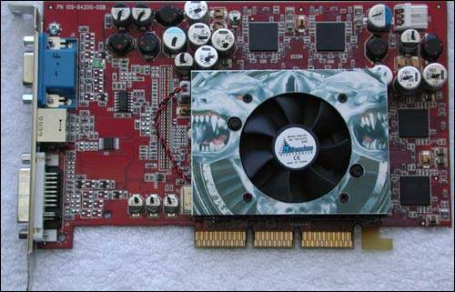
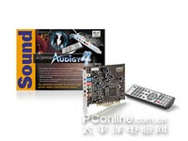
More hardware
A3D Abit升技 Add Addonics花王 Adsp ALi扬智 Amax中宇 AMD Analog Devices Aopen建基 APAC ASIO Toshiba东芝 Trident Triplex启亨 VIA威盛 Videologic VORTEX | ASUS华硕 ATrend中凌 AudioExcel Audiotrak Aureal傲锐 Aztech爱捷特 CirrusLogic Cmedia骅讯 Creative创新 Crystal Semiconductors CSUN世讯 DataExpert联讯 Voyetra Turtle Beach Wta Xitel Yamaha雅马哈 Yuan小影霸 Zoltrix速捷时 | Diamond帝盟 DIYEDEN乐之邦 Eagle金鹰 Echo Emu ESI Gamtec和跃 Genius T&W同维 Taiyanfa太阳花 Terratec德国坦克 TM Togotech岛谷科技 Topstar顶星 | Guillemot&Hercules大力神 HiTeC Hotonhitech恒邦高新 IBM InnoVISION映众 ITE联阳 Jazz Labway ESS ForteMedia Rta S3(VIA) SigmaTel SiS矽统 Soyo梅捷 Superpower上普 | Leadtek丽台 Magic3D M-AUDIO Mediatek瑞丽 Megastar皇朝 Microsoft微软 nVIDIA Octek海洋 OOAOO傲王 OPTi PcChips明致 Philips飞利浦 Pine松景 PreSonus Realtek瑞昱 RealWorld RME Rongfeng融丰
Network card, Display card, Sound card, Printer, Scanner …

Slide 15
Contents
a. Overview of Configuration Testing
b. Approaching Task
c. Obtaining the Hardware
d. Identifying Hardware Standards
e. Configuration Testing Other Hardware

Slide 16
Highlights of this chapter include
Why configuration testing is necessary
Why configuration testing can be a huge job
A basic approach to configuration testing
How to find the hardware you need to test with
What to do if you are not testing software for a desktop computer

Slide 17
What must be done?
Normally we do dynamic, white box testing for this
Don’t assume hardware standards, protocols, or specs are correct
First identify what is really going to affect the running of the software-No graphics, try standard video cards or none
Major Problem: If you suspect the fault is the hardware manufacturer, who is responsible?

Slide 18
How to handle this?
Tries to answer the question, “Does the software work correctly on a variety of hardware or, if the design called for proprietary hardware, does it run correctly on it?”
As with earlier types of testing, it is impossible to check all possibilities:
  PC, components, peripherals, interfaces, options such as memory size, device drivers,...
  Book speculates 336 display cards, 210 sound cards, 1500 modems, 1200 printers which gives a total 12 billion configurations
Ultimately, the software developers are responsible for making things work, even if the hardware is faulty

Slide 19
You can’t test all so you ...
Equivalence partition!
  What hardware is really vital?
  Game-sound and video cards important
  Word processor-handles printing
As before, might want to test
  Most popular hardware
  Only recent hardware
  Hardware that uses unique features of the software

Slide 20
Avoiding the cost of buying all that hardware ...
If you are clearly a software developer with some reputation, you can often have hardware donated or loaned for testing purposes
Some companies ask their employees to bring in units from home to run on the tests (with some incentive, of course)
Another possibility- outsource
Note the locations of hardware specs. Most are on the web

Slide 21
a. Overview of configuration testing
1. Configuration testing definition:
  Configuration testing is the process of checking the operation of the software you are testing with all these various types of hardware
2. Different configuration possibilities for a standard PC used in Homes and businesses:
  PC; Components; Peripherals;
  Interfaces; Options and memory; Device Drivers

Slide 22
a.1: Isolating Configuration Bugs (1)
1. Who should fix the bug? You discover a problem when you testing your software on a unique configuration
  Your team or hardware manufacturer?
2. How to identify Configuration bugs?
  The sure way to tell if a bug is a configuration problem and not just an ordinary bug is to perform the exact same operation that caused the problem, step by step, on another computer with a completely different configuration. If the bug does not occur, it is very likely a configuration problem. If the bug happens on more than one configuration, it is probably just a regular bug

Slide 23
a.1: Isolating Configuration Bugs (2)
3. All kinds of Bugs:
  1) Software may have a bug that appears under a broad class of configurations
  2) Software may have a bug specific only to one particular configuration
  3) The Hardware device or its device drives may have a bug that only your software reveals
  4) The hardware device or its device drives may have a bug that can be seen with lots of other software

Slide 24
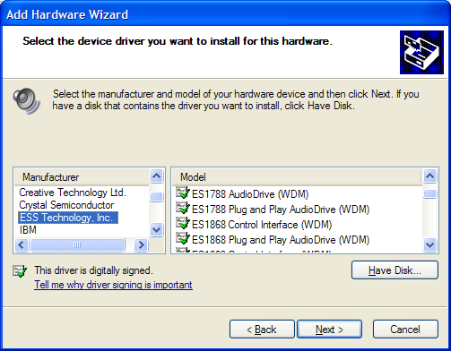
a.2: Sizing Up the Job
The job of configuration testing can be a huge undertaking. We need to figure out a way to reduce the huge set of possible configurations to the ones that matter the most
For example:

Slide 25
b. Approaching the Task (1)
The following general process that you should use when planning your configuration testing
  1) Decide the types of hardware you will need
    Look closely a your software feature set to make sure that you cover everything
  2) Decide what hardware brands, models, and device drivers are available
    Work with your sales and marketing people to create a list of hardware to test with. If they can not or won’t help, grab some recent editions and back issues of some information to get an idea of what hardware is available and what is popular
    Do some research to see if some of devices are clones of each other and therefore equivalent - falling under the same equivalence partition

Slide 26
b. Approaching the Task (2)
  3) Decide which hardware features, modes, and options are possible
    Every device has options, and your software may not need to support all of them. A good example of this is computer games
  4) Pare down the identified hardware configurations to a manageable set
    Given that you don’t have the time or budget to test everything, you need to reduce the thousands of potential configurations into the ones that matter - the ones you are going to test
Notes:
Pare down：减少

Slide 27
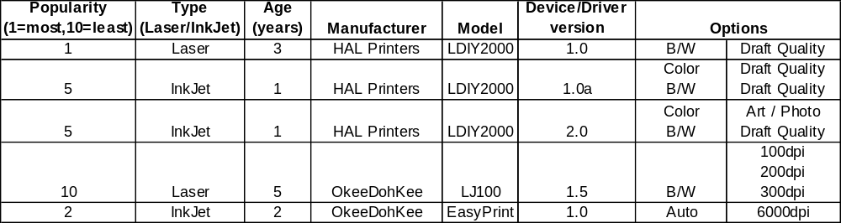
b. Approaching the Task (3)
    Ultimately, the decision-marking process that you use to equivalence partition the configurations into smaller sets is up to you and your team. There is no right formula. Every software project is different and will have different selection criteria. Just make sure that everyone on the project team, especially your project manager, is aware of what configurations are being tested and what variables went into selecting them
    For example:
Notes:
Laser/InkJet：激光/喷墨
Ultimately：最终

Slide 28
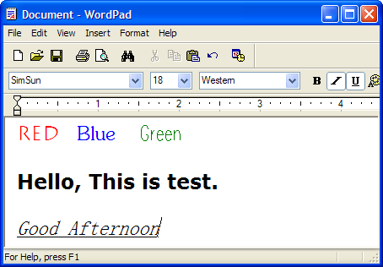
b. Approaching the Task (4)
  5) Identify your software unique features that work with the hardware configurations
    The key word here is unique. You do not want to, nor do you need to, completely test your software on each configuration
    You need to test only
    those features that are
    different from each other
    that interact with the
    hardware
    For example:

Slide 29
b. Approaching the Task (5)
  6) Design the test cases to run on each configuration
    a. Select and set up the next test configuration from the list
    b. Start the software
    c. Load in the file test.doc
    d. Confirm that the displayed file is correct
    e. Print the document
    f. Confirm that there are no error messages and that the printed document matches the standard
    g. Log any discrepancies as a bug
    In reality, the steps would be much more involved, including more detail and specifics on exactly what to do

Slide 30
b. Approaching the Task (6)
  7)Execute the tests on each configuration
    You need to run the test cases and carefully log and report your results to your team, and to the hardware manufacturers if necessary
  8) Rerun the tests until the results satisfy your team
    It is not uncommon for configuration testing to run the entire course of a project. Initially a few configurations might be tried, then a full test pass, then smaller and smaller sets to confirm bug fixes. Eventually you will get to a point where there are no known bugs or to where the bugs that still exist are in uncommon or unlikely test configurations. At that point, you can call your configuration testing complete

Slide 31
c. Obtaining the Hardware
How to obtaining the all kinds of hardware unless buy?
Buy only the configurations that you can or will use most often
Contact the hardware manufacturers and ask if they will lend or even give you the hardware
Send a memo or email in your company asking what hardware they have in their office or even at home - and if they would allow you to run a few tests on it
If you have the budget, work with your project manager to contract out your test work to a professional configuration and compatibility test lab
Notes:
Compatibility：兼容性

Slide 32
d. Identifying Hardware Standards
Knowing some details of the hardware specifications can help you make more informed equivalence partition decisions
We can find the detail hardware specifications from internet
  http://www.pcdesignguide.org
  http://www.msdn.microsoft.com/certification
  http://microsoft.com/hwtest
A easy way is search engine http://www.google.com

Slide 33
e. Configuration Testing Other Hardware
It does not matter what the hardware and software is and what it connects to; if it connects to anything else, configuration issues need to be tested
Create equivalence partitions of the HW based on input from the people who work with the equipment, your project manager, or your sales people
Develop test cases
Collect the selected hardware
Run the tests

Slide 34
Exercise
Software Testing, Page 140: 2, 6
  How can you tell if a bug you find is a general problem or a specific configuration problem?
  Is it acceptable to release a software product that has configuration bugs?

